Slide 1
GOING SOLAR IN MAINE: WHY AND HOW
Fred Horch,
Rotary Club of Brunswick

Slide 2
WHY GO SOLAR
1
2
3
Permanently lower energy prices for everyone.
Sustain and grow a better economy.
Protect and promote healthier conditions for people on Earth.

Slide 3
SOLAR ENERGY
Solar energy powers the entire natural world. It is the most abundant and sustainable source of energy on our planet. Going solar is tapping into an endless supply of clean energy that is sufficient to power all human needs now and for the foreseeable future.

Slide 4
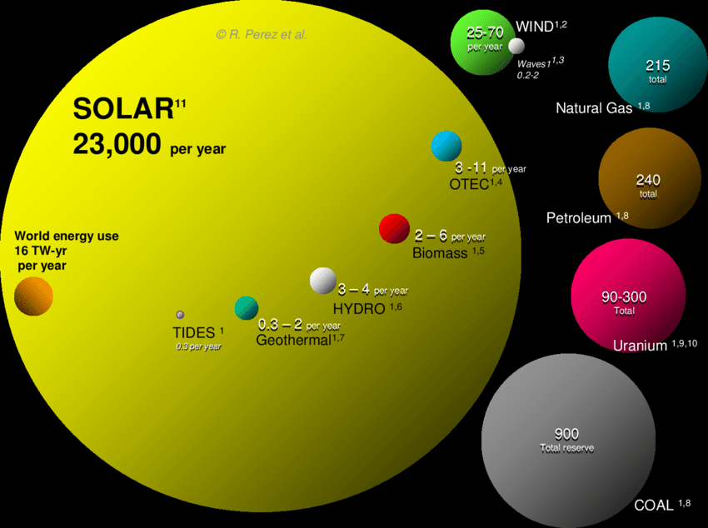
ANNUAL SOLAR RESOURCE COMPARED TO OTHER ENERGY TOTAL RESERVES
Solar energy is by far Earth’s largest energy resource.
Every three weeks the sun delivers more energy than all the coal deposits in the world.
Solar power is more than 300 times more abundant than wind power.

Slide 5
MORE SOLAR POWER BENEFITS EVERYONE THROUGH LOWER ENERGY PRICES
Solar power is delivered around the world for free every day. Harnessing this free resource reduces energy prices for everyone.

Slide 6
GOING SOLAR INCREASES ENERGY SUPPLY, REDUCES ENERGY DEMAND

Slide 7
SOLAR ON YOUR ROOF

Slide 8
SOLAR IN YOUR YARD

Slide 9
SOLAR FARM

Slide 10
SOLAR TODAY: BURN LESS GAS
Solar on Sunny Days
Natural Gas on Cloudy Days or Nights

Slide 11
SOLAR TOMORROW: NO GAS NEEDED
Solar on Sunny Days
Batteries for Cloudy Days or Nights

Slide 12
Energy is the lifeblood of the global economy – a crucial input to nearly all of the goods and services of the modern world.
World Economic Forum

Slide 13
SOLAR ENERGY: MADE IN MAINE POWER
Maine Has No Fossil Fuel Reserves
Maine Has PLENTY of Sun
100% of the fossil fuel burned in Maine for energy must be imported from out of state.
Every year, fossil fuel costs Maine $4 billion.
Maine’s economy will collapse if out-of-state suppliers stop providing us with fossil fuel for more than a few weeks.
The entire state of Maine receives sunlight: it is an evenly-distributed energy resource free for the taking wherever you live and work.
20 square feet of full-sun roof area in Maine produce more than 450 kilowatt hours of electricity per year—enough energy to drive a Tesla 1,300 miles.
300 square feet (12 feet by 25 feet) of solar panels in Maine produce as much electricity as an average Maine household uses per year.

Slide 14
MAINE’S $4 BILLION QUESTION
Spend $4 billion per year on fossil fuel?
Spend $4 billion per year on solar power?
Buy $4 billion of fossil fuel.
Burn it for energy.
Release pollution into our air and water.
Hope the price of fossil fuel doesn’t go up.
Borrow money.
Pay $4 billion per year to repay the loan.
Use the money we’ve borrowed to install solar panels on our homes, small businesses, parking lots, capped landfills and other sunny places.
Generate electricity without releasing any pollution into our air and water.
Hope the sun doesn’t burn out.

Slide 15
WHO BENEFITS IN MAINE FROM SOLAR POWER
Farmers Earn income from solar Supply own energy
Manufacturers Lower costs More reliable supply
Retailers Lower costs Supply own energy
Homeowners Lower costs Supply own energy

Slide 16
NOTHING ELSE MATTERS IF YOU CAN’T BREATHE.
American Lung Association

Slide 17
SOLAR POWER: CLEAN, QUIET, RELIABLE
Air
Water
Noise
Motion
Warranty
Solar panels produce electricity without burning fuel. You can enjoy power without pollution.
Unlike hydro, coal and nuclear power plants, solar photovoltaic panels do not require any water to produce power.
Unlike wind turbines, solar panels produce power in complete silence.
Unlike hydro, tidal, wind, gas, nuclear and coal power plants, solar panels produce power with no moving parts.
Most solar panels have a 25-year warranty and an expected useful life of 30 years. Solar panels installed 30 years ago are still producing power today.

Slide 18
COMMON QUESTIONS ABOUT SOLAR POWER
Sustainability
Practicality
Affordability
It takes about 200 kWh of energy to make a solar panel.
If installed in a sunny spot in Maine, over its useful life a solar panel will produce between 8 and 30 times as much energy as it takes to make.
Producing electricity on site with solar panels has less environmental impact than any other energy source.
Snow slides right off solar panels in the winter.
Rain cleans dirt off solar panels in the spring, summer and fall.
Electricity from solar panels can be used just like power you buy from a utility.
You can install solar in any sunny spot or subscribe to a solar farm.
If you can take out a 15 or 30-year loan, generating your own solar power is cheaper than buying power from a utility.
You can lower your utility power costs by 15% by subscribing to a solar farm.

Slide 19
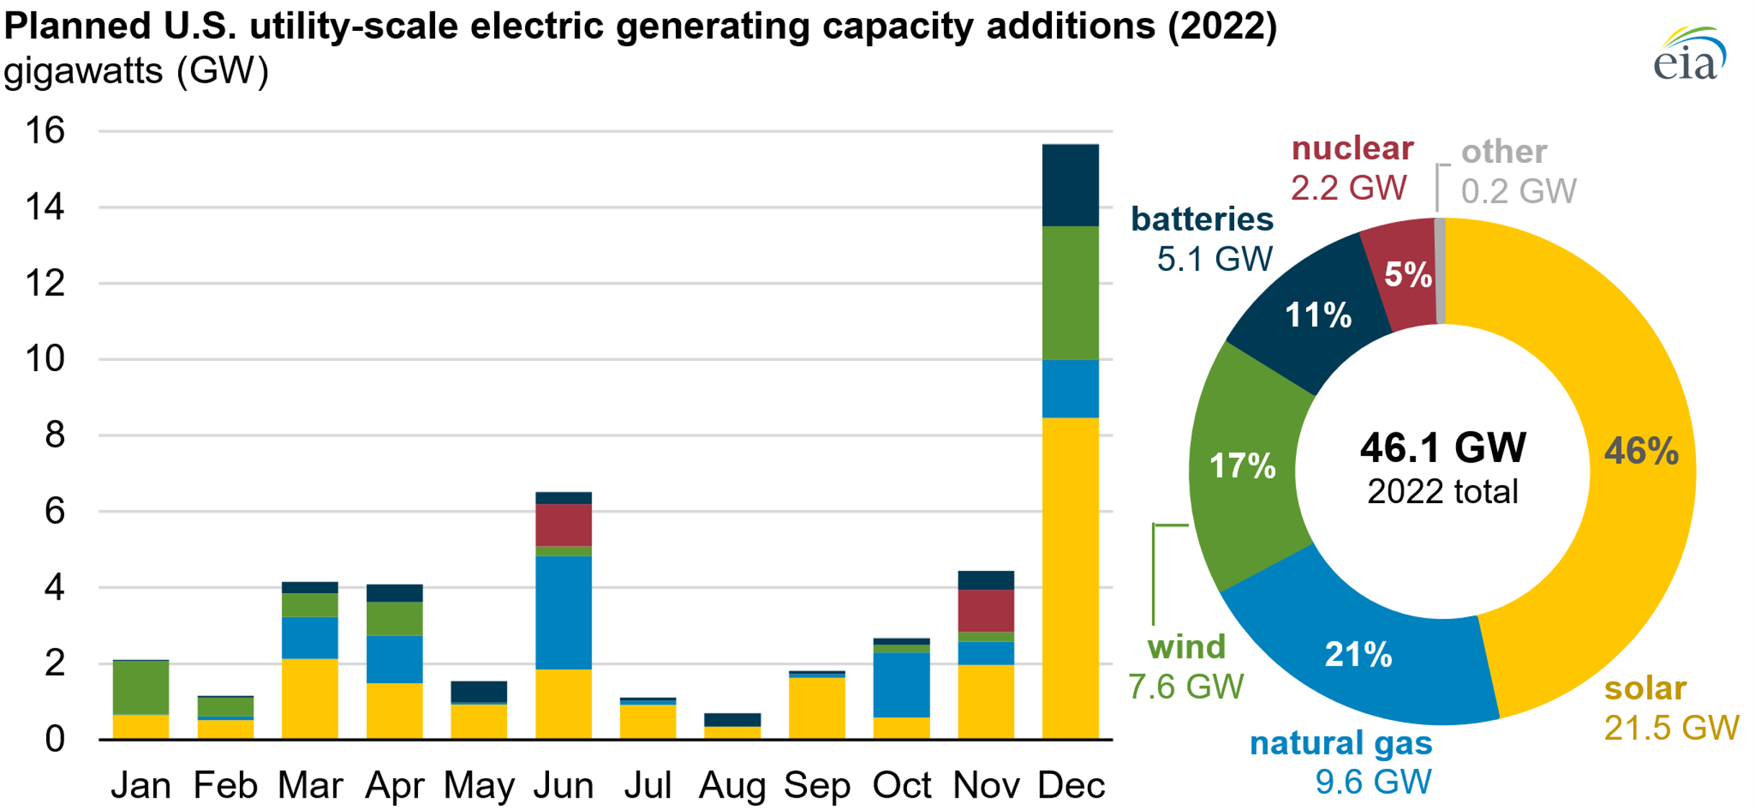
SOLAR: NOW MOST AFFORDABLE ENERGY SOURCE
The US Energy Information Administration says solar power will account for nearly half of new U.S. electric generating capacity in 2022.
New solar projects around the world are bidding at 1.5 cents or less per kilowatt hour.

Slide 20
SUMMARY
Generating your own solar power is cheaper than ​buying electricity from a utility.
By installing solar panels, you increase the supply of electricity and decrease the demand for electricity, which leads to lower energy prices for everyone.
When installed in any sunny location in Maine, solar panels will reliably produce power for 30 years without making any noise or emitting any pollution.

Slide 21
THANK YOU
Fred Horch | fred.horch@gmail.com | www.BrunswickMaineRotary.org

